Slide 1

Orion Network Architecture Options for APAC
Comprehensive Analysis of Pros, Cons, Risks, and Mitigation Strategies for Centralized vs. Distributed SolarWinds Deployments

Slide 2
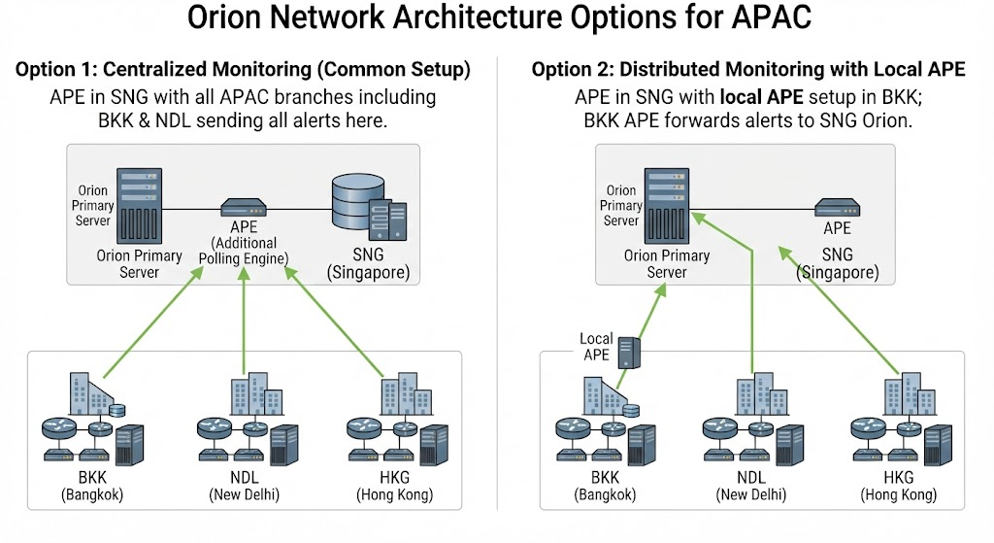

Slide 3


Executive Overview
Objective
Architecture Choices
•
Evaluate two distinct SolarWinds Orion architectures for APAC branch offices (specifically Bangkok & New Delhi).
•
Option 1: Centralized SolarWinds Orion setup with APE in Singapore (SNG); all APAC branches (incl. BKK, NDL) send alerts directly.
•
Balance operational overhead, network resilience, alert latency, and infrastructure cost.
•
Option 2: Distributed setup featuring a local Additional Polling Engine (APE) in Bangkok, forwarding alerts back to the central SNG Orion server.
•
Establish robust risk mitigation plans for seamless regional monitoring.

Slide 4


Architecture Visual Reference
Topology Comparison
Visualizing the data and alert flows between central Singapore (SNG) and regional branches like Bangkok (BKK) and New Delhi (NDL).
Option 1 relies on WAN links for all poll-to-alert cycles.
Option 2 keeps polling localized in BKK, reducing WAN jitter impact.

Slide 5
Deep Dive Analysis
Option 1: Centralized Monitoring
Common SLW Orion setup with APE in SNG; all APAC branches sending alerts directly.

Slide 6


Option 1: Pros & Cons
Advantages (Pros)
Disadvantages (Cons)
•
Simplified Administration: Single central server and APE to patch, maintain, and upgrade.
•
WAN Dependency: Highly vulnerable to cross-border WAN latency, packet loss, and intermittent link stability.
•
Lower Infrastructure Costs: No requirement for physical servers, OS licensing, or hardware maintenance at local branch offices.
•
False Positives on Flapping: Brief WAN blips can trigger false critical alerts for BKK/NDL infrastructure.
•
High Bandwidth Consumption: Continuous polling traffic traversing international links to SNG.
•
Centralized Alerting Policies: Easier enforcement of unified notification workflows and global escalation rules.
•
Streamlined Access Control: Single source of truth for all engineering teams viewing regional dashboards.

Slide 7


Option 1: Risks & Mitigation Plan
Identified Risks
Mitigation Strategy
•
WAN Outage Blind Spots: Complete loss of branch visibility if the international circuit drops.
•
Advanced Polling Settings: Increase polling intervals and warning thresholds to tolerate high-latency links.
•
Alert Flooding: Massive alert storms during regional carrier route flaps.
•
Orion HA / Failover: Ensure redundant WAN paths (MPLS + Secure SD-WAN) connecting BKK and NDL to SNG.
•
Polling Timeouts: High latency causing delayed metric collection and inaccurate threshold evaluations.
•
Dependency Mapping: Configure SolarWinds parent-child dependencies so WAN gateway failures suppress individual node alerts.

Slide 8
Deep Dive Analysis
Option 2: Distributed Monitoring with Local APE
Central SNG Orion setup with a dedicated local APE setup in Bangkok forwarding alerts.

Slide 9


Option 2: Pros & Cons
Advantages (Pros)
Disadvantages (Cons)
•
WAN Resiliency & Local Buffering: Local APE buffers polling data during WAN outages and syncs when restored.
•
Higher Footprint & Cost: Requires local hardware/VM hosting, OS licensing, and maintenance support in Bangkok.
•
Reduced False Alarms: Eliminates false positives caused by international network jitter between BKK and SNG.
•
Operational Complexity: Managing distributed software versions, patches, and local component health across borders.
•
Optimized Bandwidth: Raw polling stays local; only compressed telemetry and alert states traverse the WAN.
•
Local Hands Dependency: Troubleshooting local APE host issues relies on on-site staff availability.
•
Accurate Metric Timing: Local polling engine ensures precise performance data collection for Bangkok assets.

Slide 10


Option 2: Risks & Mitigation Plan
Identified Risks
Mitigation Strategy
•
APE Service Failure: Undetected crashes of the local BKK APE causing prolonged local monitoring blind spots.
•
Self-Monitoring Alerts: Set up synthetic heartbeat monitors on the central SNG server to alert immediately if BKK APE stops checking in.
•
Database Synchronization Lag: Queue backups and conflicts when WAN link restores after a lengthy outage.
•
Standardized Deployment: Use automated configuration templates and pre-built VM images to simplify remote APE maintenance.
•
Local Resource Constraints: Inadequate sizing of the BKK server host leading to polling bottlenecks.
•
Queue Tuning: Configure appropriate buffer thresholds and storage allocation on the local APE node.

Slide 11
Comparative Evaluation Matrix
Evaluation Criteria | Option 1 (Centralized SNG APE) | Option 2 (Distributed with Local BKK APE)
Initial Setup Cost | Low (No local branch hardware needed) | Medium (Requires local VM/server)
WAN Reliability Impact | High (Direct dependency on link stability) | Low (Local polling continues during outage)
Operational Overhead | Minimal (Single point of maintenance) | Moderate (Multi-site component management)
Data Integrity & Accuracy | Vulnerable to jitter and latency | High (Local polling removes WAN delay)

Slide 12




Strategic Recommendation
Recommended Choice
Hybrid Hybrid Approach
Tuning & Rules
Implementation
–
Option 2 is recommended for mission-critical branch operations in Bangkok due to WAN resilience.
–
Implement robust parent-child dependency mapping in Orion to eliminate false alarm chatter.
–
Phase 1: Pilot local APE in BKK. Phase 2: Review telemetry stability and roll out alerts.
–
Deploy local APE in high-tier branches (BKK) while maintaining centralized polling for smaller regional offices (NDL).

Slide 13
Questions & Discussion
Thank you for your time. Open for feedback and architecture alignment.

